Slide 1


Model-based medical image analysis
Ela Claridge
School of Computer Science

Slide 2
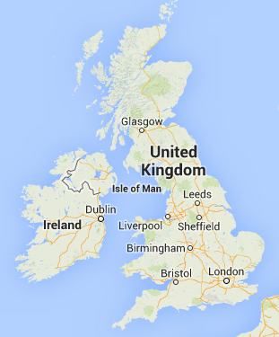
Birmingham

Slide 3
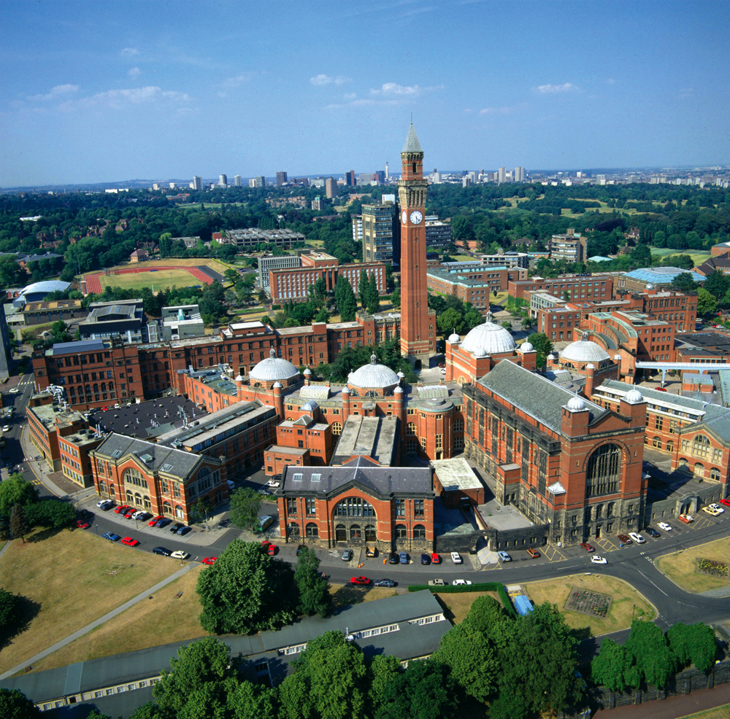
University of Birmingham

Slide 4
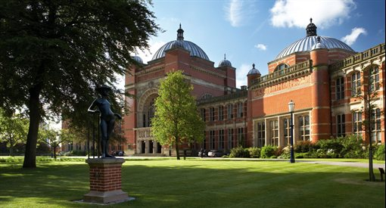
University of Birmingham
~27,000 students from 138 countries
~7 staff
Over 100 departments
8 Nobel Prize winners

Slide 5
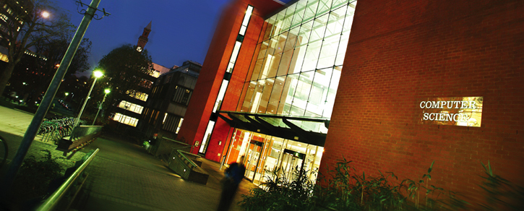
School of Computer Science
Computer Science at Birmingham dates back to the late 1950s; our School of Computer Science became one of the first academic departments in the UK to undertake research and teaching in this field.

Slide 6
School of Computer Science
Undergraduate teaching
BSc Computer Science
MSci Computer Science
BSc Artificial Intelligence and Computer Science
BSc Computer Science with Business Management
MEng Computer Science and Software Engineering
BA Computer Studies and an Arts subject
BSc/MSci Mathematics and Computer Science

Slide 7
School of Computer Science
MSc
Security
Advanced Computer Science
Human-Computer Interaction
Robotics
Natural Computation
Interdisciplinary Optimisation
Physical Sciences of Imaging for Biomedicine

Slide 8
Research groups
Machine Learning
Robotics
Medical Image Interpretation
Artificial Intelligence
Formal Verification and Security
Parallel and Distributed Computing
Theoretical Computer Science
Software Engineering
We are ranked 7th in the UK for research that is world-leading in its originality, significance and rigour.

Slide 9
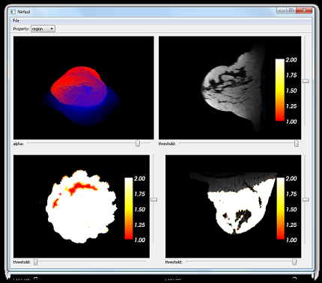
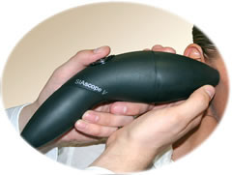
Medical Imaging and Image Interpretation Group
Our focus is on finding novel, non-invasive methods of acquiring image data and extracting diagnostic information from these data.

Slide 10
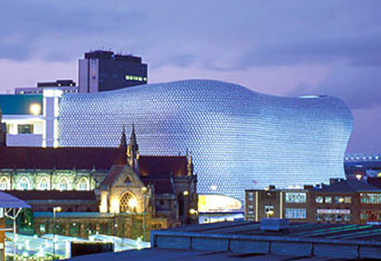
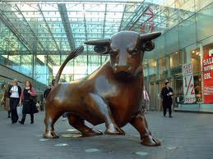
Birmingham
The most populous British city outside the capital London
Over 1,000,000 inhabitants in the city
Over 3,500,000 inhabitants in the metropolitan area

Slide 11
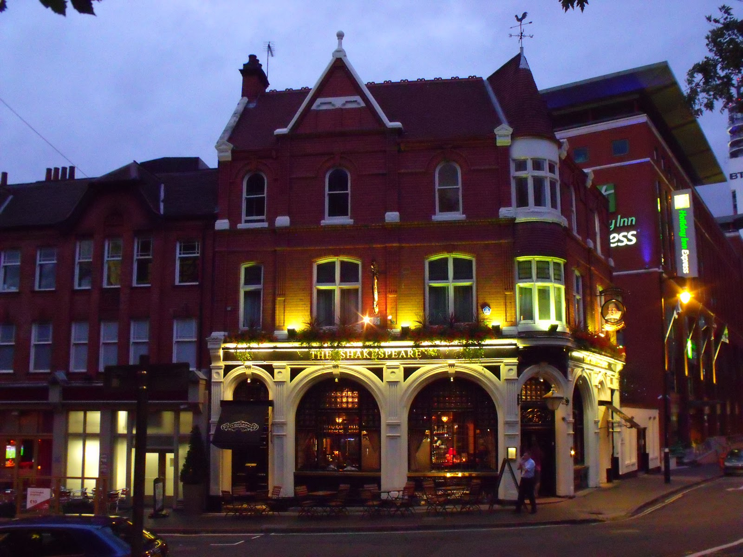

Birmingham
Ethnically diverse: 47% non-Caucasian British

Slide 12
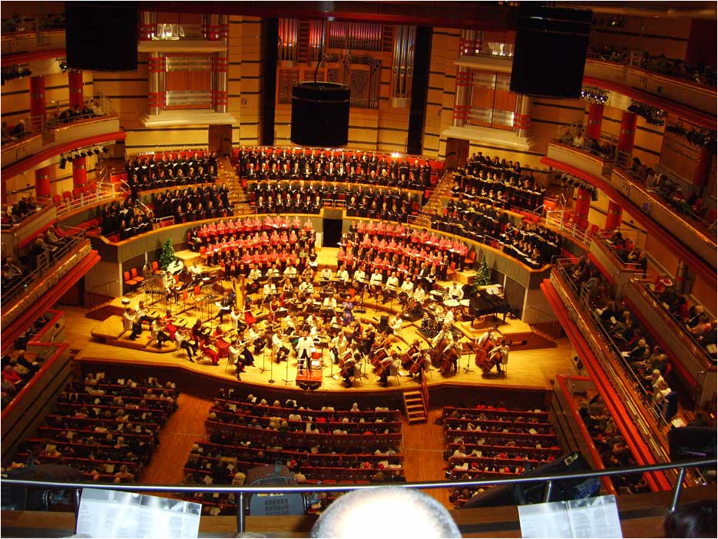
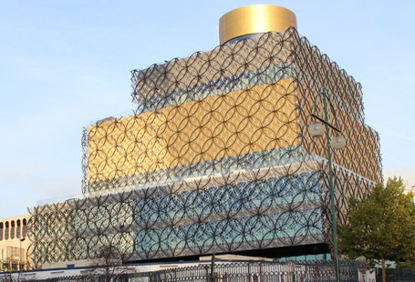
Birmingham
Symphony Hall
Public Library

Slide 13
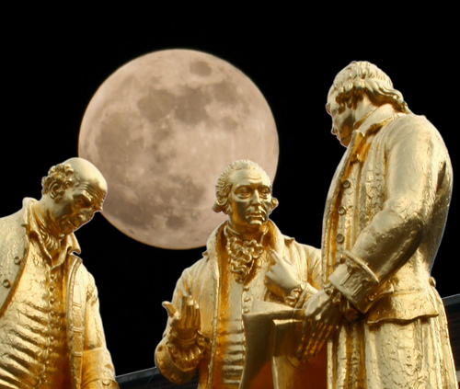
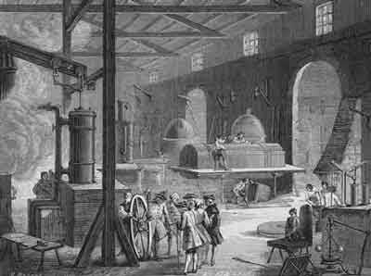
Birmingham: home of the Industrial Revolution
Lunar Society (1765 - )

Slide 14
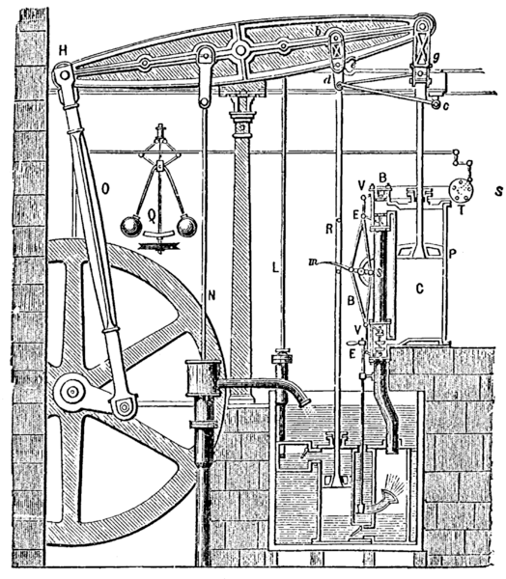
Birmingham: home of the Industrial Revolution
Matthew Boulton
James Watt

Slide 15

Birmingham: home of interdisciplinary research
Jonathan Stokes
Joseph Priestley
Erasmus Darwin

Slide 16
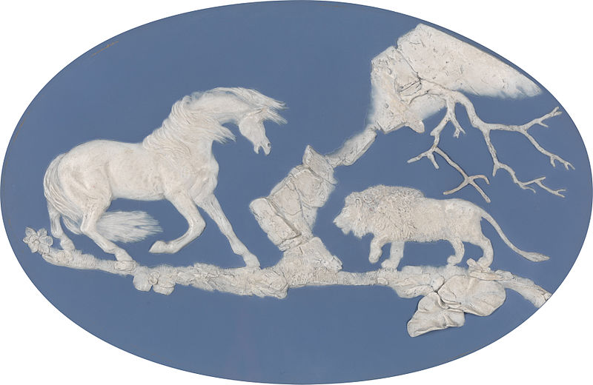
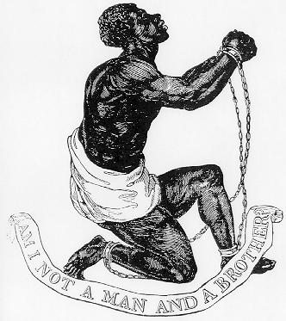
Birmingham: home of interdisciplinary research
Josiah Wedgwood

Slide 17
Birmingham: home of interdisciplinary research
Samuel Galton
Created the statistical concept of correlation and regression toward the mean.
The first to apply statistical methods to the study of human differences and inheritance of intelligence, and introduced the use of questionnaires and surveys.

Slide 18


